Slide 1
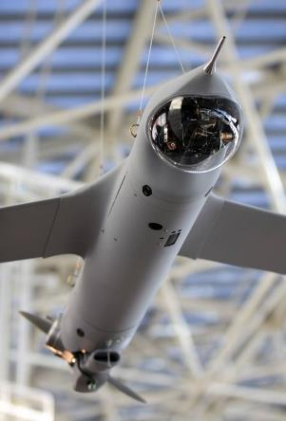
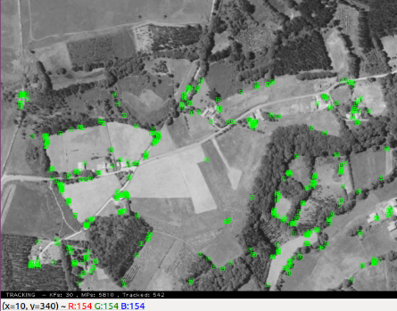
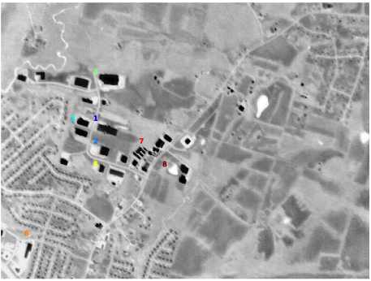

Problem Statement
UAVs need to be able to navigate with onboard cameras.
Temperature fluctuations, vibrations, zoom functionalities, etc. all can make a laboratory calibration invalid
Accurate navigation is very sensitive to a good calibration though.
Autocalibration in flight is a solution, yet at altitude, scene is mostly planar, making traditional methods inapplicable
Need to take advantage of the scene structure!
[Triggs ’98] first presented a method specifically dedicated to planar scenes based upon inter-image homographies

Slide 2
Technical Approach
“Forget the checkerboard: practical self-calibration using a planar scene”
Herrera et. Al, WACV 2016
Asm.
Assumptions
Planar scene
Camera
zero-skew
Radial distortion model
Step 1
Feature Extraction
& Matching
SIFT feature extraction
FLANN matching
Filtering
Step 2
Projective
Reconstruction
Homography estimation
RANSAC
Step 3
Projective
Bundle Adjustment
Initial estimation of distortion and Central Point
Refinement of Homographies and world coordinates of scene points

Slide 3
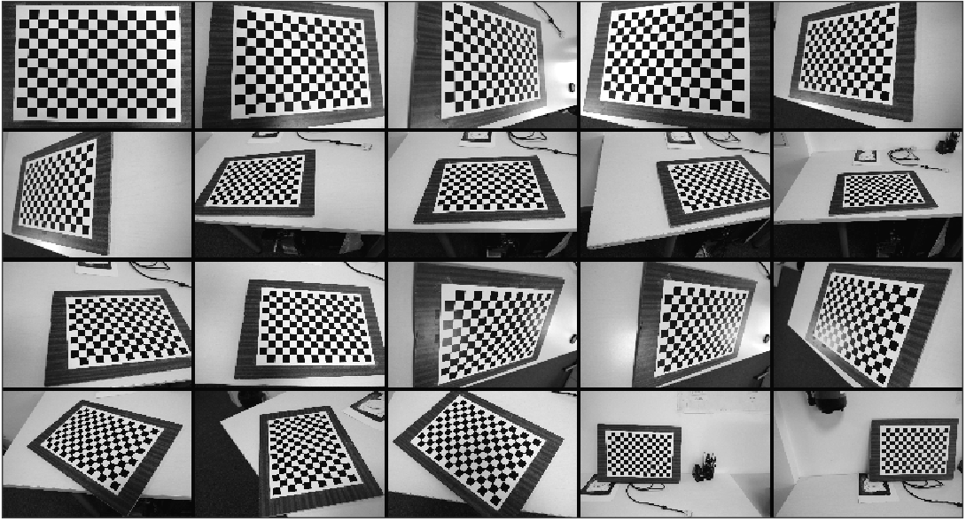
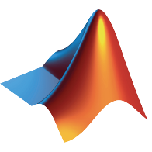
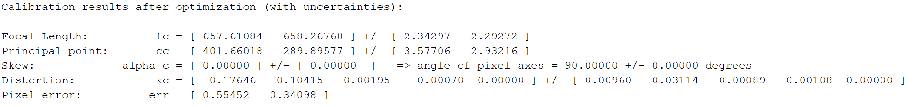
Results – Close Range Imagery (1/3)
Baseline calibration
DSLR + 18mm lenses
Checkerboard pattern
Resized to 800x533 px
Matlab Calibration Toolbox
[18.25, 18.27 ] mm
norm(err) = 0.65

Slide 4
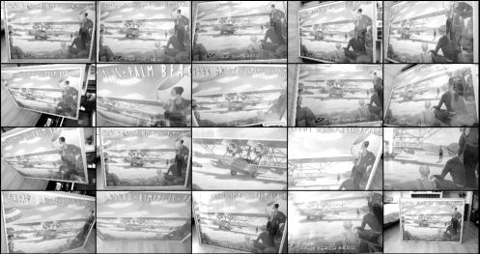

Results – Close Range Imagery (2/3)
Planar Self-Calibration
DSLR + 18mm lenses
Pictures of poster
Resized to 800x533 px
Custom Python implementation
Focal Length | fx | 664.954 (18.45 mm)
 | fy | 666.036 (18.49 mm)
Principal Point | u | 425.684
 | v | 283.173
Distortion | d0 | 3.75E-07
 | d1 | 3.96E-13
Pixel Error |  | 0.5832

Slide 5
Results – Close Range Imagery (3/3)
Results Planar Self-Calibration vs Checkerboard
Focal Length very accurate ~ 1.2%
Less accurate Principal point ~ 2.5 – 6 %
Reprojection error slightly better than Checkerboard
High error in distortion, probably due to different
Distortion models
 |  | Checkerboard Cal. | Planar Self-Cal. | Deviation( %)
Focal Length | fx | 657.611 (18.25 mm) | 664.954 (18.45 mm) | 1.12
 | fy | 658.268 (18.27 mm) | 666.036 (18.49 mm) | 1.18
Principal Point | u | 401.66 | 425.684 | 5.98
 | v | 289.896 | 283.173 | 2.32
Distortion | d0 | -1.76E-01 | 3.75E-07 | 100.00
 | d1 | 1.04E-01 | 3.96E-13 | 100.00
Pixel Error |  | 0.65 | 0.58 | 10.28

Slide 6

Results – Satellite Imagery (3/3)
osgEarth is used to transform satellite orthoimagery to a given virtual camera perspective
 |  | Specified Cal. | Planar Self-Cal. | Deviation( %)
Focal Length | fx | 1117.65 | 1527.25 | 36.7
 | fy | 1117.65 | 1455.30 | 30.3
Principal Point | u | 511.5 | 480.65 | 6.0
 | v | 383.5 | 415.15 | 8.3
Distortion | d0 | 0 | -3.29E-09 | -
 | d1 | 0 | -1.2515E-14 | -
Pixel Error |  | N/A | 0.07 | -
Poor results
Large estimation errors even though plane is performing roll maneuver in sample images, i.e. rotation + translation.
Measures to improve numerical conditioning for optimization:
normalized feature points, program Jacobians for bundle adjustments, select homographies with best condition numbers

Slide 7
Conclusions
[Herrera ’16] Autocalibration fully implemented in Python
Close-range imagery results:
Runway imagery results:
Satellite imagery results:
Need to further take advantage of the scene structure to get yet better results for this application.
[Yang ’19] presented a method specifically dedicated to autocalibrate planar scenes with pure translational movement

